Slide 1

MOVIE RECOMMENDATION SYSTEM
TEAM MEMBERS
KASANUR JYOTHIRADHITHYA [RA2011003010416]
PRANISHA.R [RA2011003010427]
YESWANTH.J.B [RA2011003010432]

Slide 2
ABSTRACT
This project aims to develop a movie recommendation system that usually predict what movies a user will like based on the attributes present in previously liked movies. Such recommendation systems are beneficial for organizations that collect data from large amounts of customers, and wish to effectively provide the best suggestions possible. A lot of factors can be considered while designing a movie recommendation system like the genre of the movie, actors present in it or even the director of the movie. The system also analyzes the sentimental analysis to identify the emotional tone of movie and recommend films accordingly. Overall the system provides an effective and user-friendly way for the users to discover new movies and enjoy.

Slide 3
LITERATURE SURVEY

Slide 4
S.No | Title | Author Name and Year of Publication | Methodology | Inference | Drawbacks
1. 2. | A Collaborative Filtering Recommendation Algorithm for Movie Recommendation System A Hybrid Movie Recommendation System using Content-based and Collaborative Filtering Approach | by Yanping Gao et al (2021) by Aarti Sharma et al (2021) | This paper proposes a collaborative filtering algorithm based on the user's ratings and movie genres to recommend movies to users. The authors used the MovieLens dataset to evaluate the proposed algorithm's performance. This paper proposes a hybrid recommendation system that combines content-based and collaborative filtering approaches to provide personalized movie recommendations. The authors evaluated the proposed system using the MovieLens dataset. | The proposed algorithm outperformed the baseline algorithms in terms of accuracy. The proposed hybrid system outperformed the standalone content-based and collaborative filtering systems. | The algorithm does not consider the user's temporal changes in preferences and may not be suitable for new users. The system may suffer from the cold start problem, and the recommendation quality may degrade as the size of the dataset increases.

Slide 5
S.No | Title | Author Name and Year of Publication | Methodology | Inference | Drawbacks
3. 4. | A Novel Movie Recommendation System based on Deep Learning and Collaborative Filtering A Survey on Movie Recommendation Systems | by Li Zou et al (2020) by Vanshika et al (2020) | This paper proposes a novel movie recommendation system based on deep learning and collaborative filtering techniques. The authors used a hybrid neural network model that combines the user's historical behavior and movie content to make recommendations. The proposed model was evaluated on the MovieLens dataset. This paper provides a comprehensive survey of various movie recommendation systems, including collaborative filtering, content-based filtering, knowledge-based filtering, and hybrid filtering techniques. | The proposed model outperformed the traditional collaborative filtering algorithms. The paper highlights the strengths and weaknesses of each approach and provides insights into the current research trends in the movie recommendation system. | The model requires a large amount of data to train, and it may not be suitable for small datasets. The paper does not propose any new algorithms or techniques for movie recommendation systems.

Slide 6
S.No | Title | Author Name and Year of Publication | Methodology | Inference | Drawbacks
5. | A Scalable Collaborative Filtering Algorithm for Large-scale Movie Recommendation System | by Yang Li et al (2019) | This paper proposes a scalable collaborative filtering algorithm based on matrix factorization to improve the efficiency and scalability of the movie recommendation system. The authors evaluated the proposed algorithm using the Netflix dataset. | The proposed algorithm outperformed the traditional collaborative filtering algorithms in terms of both accuracy and scalability. | The algorithm may suffer from the sparsity problem, and it may not be suitable for small datasets.

Slide 7
Comparison of Existing methods with merits and demerits
EXISTING SYSTEMS | MERITS | DEMERITS
Matrix Factorization | 1.Matrix factorization can overcome the sparsity problem in collaborative filtering by using machine learning techniques to identify latent factors that influence user preferences. 2.Matrix factorization can provide more accurate recommendations than traditional collaborative filtering methods. | 1.Matrix factorization can be computationally expensive and requires large amounts of data. 2.Matrix factorization can suffer from overfitting if the model is not properly regularized.
Collaborative Filtering | 1.Collaborative filtering is one of the most widely used techniques for movie recommendation systems because it is simple and effective. 2.It relies on user data, which means that it can provide recommendations that are tailored to individual users. | 1.Collaborative filtering suffers from the cold-start problem, which means that it cannot make recommendations for new users who have not provided any ratings or preferences. 2.Collaborative filtering is also susceptible to sparsity, which means that it can struggle to make accurate recommendations when there are not enough ratings or preferences available

Slide 8
Data Sets
MovieLens Dataset: This is one of the most widely used datasets for movie recommendation systems. It contains movie ratings from users on a scale of 1 to 5, along with movie metadata such as title, genre, and year of release. It is available in different sizes ranging from 100,000 ratings to 25 million ratings.
IMDB Dataset: The Internet Movie Database (IMDB) is a popular website that provides information on movies, TV shows, and celebrities. The IMDB dataset contains information on movies such as title, genre, rating, and cast.
Kaggle Dataset: This dataset contains 100K data points of various movies and users.
Flixster Dataset: Flixster is a movie recommendation website that provides information on movies, ratings, and reviews. The Flixster dataset contains information on movies such as title, genre, rating, and cast, along with user ratings and reviews.
Yahoo! Movies Dataset: This dataset contains information on movies such as title, genre, rating, and cast, along with user ratings and reviews.
The Movies Dataset: This dataset contains information on movies such as title, genre, rating, and cast, along with additional metadata such as budget, revenue, and runtime. It also includes links to movie trailers and posters.

Slide 9
Challenges to address
Developing an effective movie recommendation system involves addressing several challenges, including:
Data sparsity: Movie recommendation systems rely on user-item interaction data to make recommendations.
Cold start problem: When a new user joins the system or a new movie is added to the system, there is limited data available to generate recommendations.
Diversity: Movie recommendation systems need to balance providing relevant recommendations with introducing users to new and diverse content. This can be challenging, as users may have narrow or specific preferences, and the system may need to consider the popularity and quality of the movies being recommended.
Scalability: It requires efficient algorithms and scalable architectures to handle large datasets of movies and users and generate recommendations in real-time.
Evaluation: Evaluating the performance of a movie recommendation system can be challenging, as there are different metrics to consider, and the system's performance may vary depending on the user's preferences and the types of movies being recommended.
To address these challenges, movie recommendation systems typically incorporate a combination of techniques, including collaborative filtering, content-based filtering, matrix factorization, deep learning, and hybrid approaches.

Slide 10
Problem Statement and Objectives
The problem addressed in this project is to develop an effective and accurate movie recommendation system that can suggest personalized movies to users based on their past preferences.
The goal is to provide a user-friendly platform that enables users to discover new movies that align with their interests and emotional preferences. The system needs to be scalable, able to handle a large dataset of movies, and be capable of making real-time recommendations. Furthermore, the system should be evaluated using appropriate metrics to ensure that it provides accurate and relevant recommendations to users.
The project aims to address the challenge of developing a movie recommendation system that effectively integrates different techniques and approaches, such as collaborative filtering, content-based filtering, and deep learning, to improve the recommendation quality. Ultimately, the goal of this project is to provide a useful tool for movie enthusiasts to discover and enjoy new movies

Slide 11
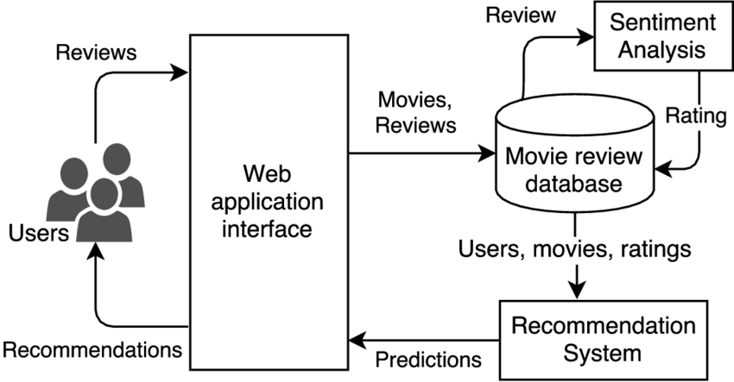
Architecture/Block Diagram of the Proposed model

Slide 12
Modules Description and Implementation
Some of the modules involved in this project are:
Data Collection and Preprocessing Module: This module is responsible for collecting and preprocessing movie data from various sources, such as IMDb and Rotten Tomatoes.
Feature Extraction Module: This module is responsible for extracting relevant features from the movie data, such as genre, director, actors, and ratings.
User Modeling Module: This module is responsible for building a user model that captures the user's movie preferences based on their past behavior.
Recommendation Engine Module: This module is responsible for generating personalized movie recommendations for users based on their preferences.
User Interface Module: This module is responsible for providing a user-friendly interface for users to interact with the system.
Overall, implementing a movie recommendation system involves combining these modules to provide accurate and relevant movie recommendations to users.

Slide 13
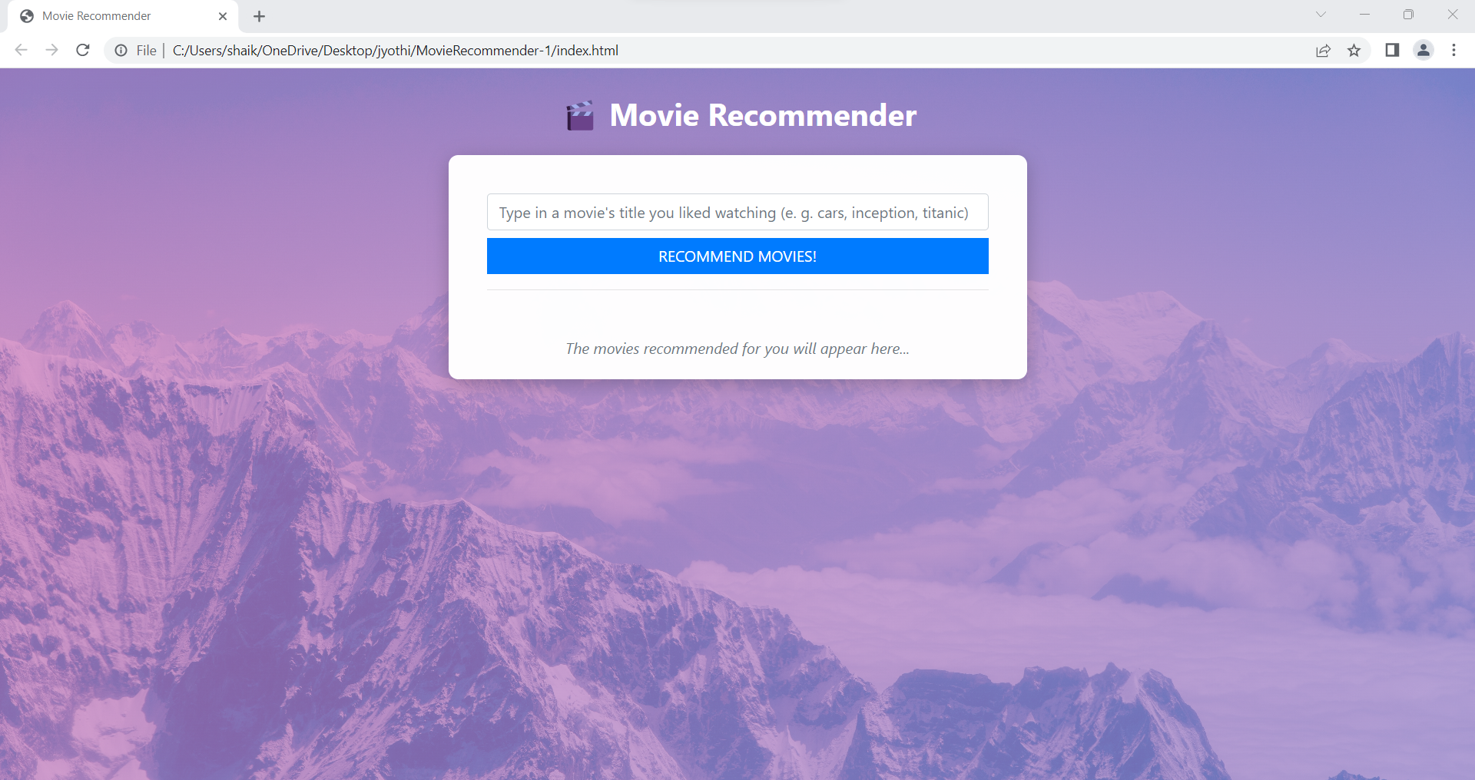
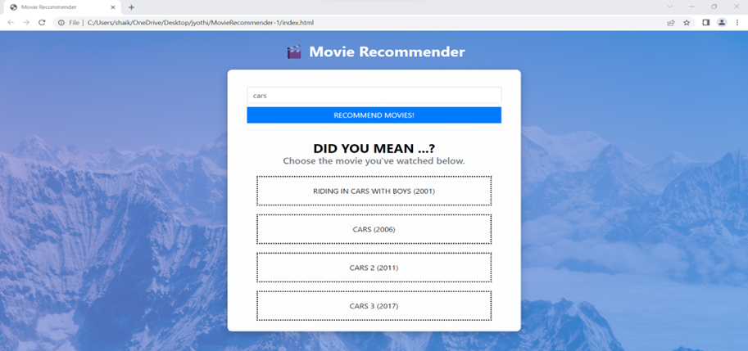
Output

Slide 14
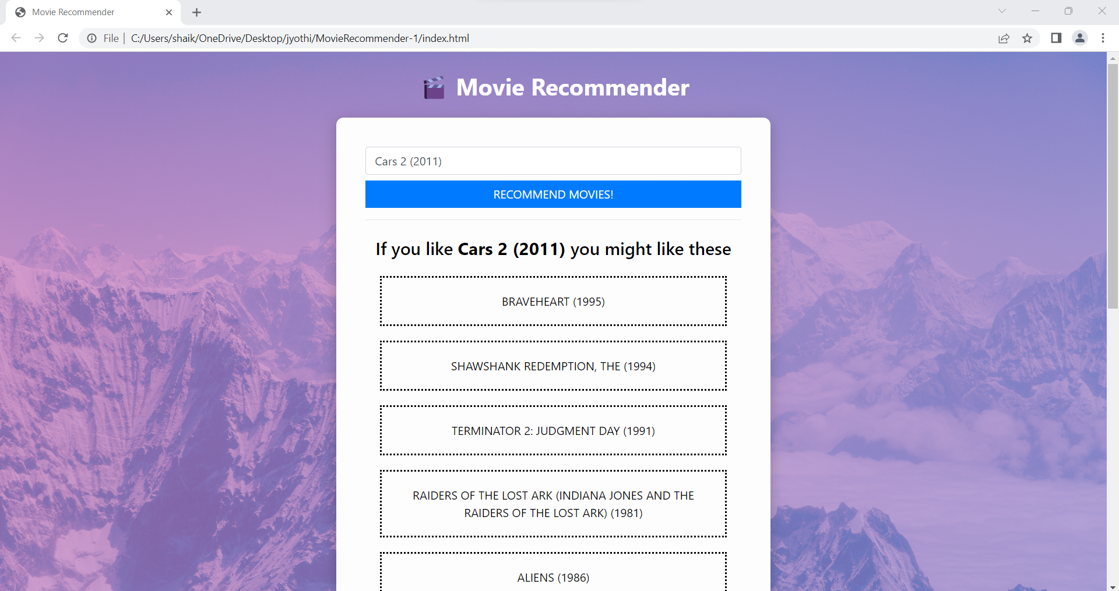
Output

Slide 15
Conclusion
A movie recommendation system is built using cosine similarity in artificial intelligence. Cosine similarity is a metric used to measure how similar the documents are irrespective of their size, here data of several movies and reviews are collected with the help of API’s and are compared. The recommendations are given based on similarity and cast. We can use the movie recommendation system for recommendations of shows worth watching based on past interests.

Slide 16
References
L. T. Ponnam, S. Deepak Punyasamudram, S. N. Nallagulla, and S. Yellamati, “Movie recommender system using item-based collaborative filtering technique,” in 1st International Conference on Emerging Trends in Engineering Technology and Science, ICETETS 2016 - Proceedings, (ICETETS, 2016)
J.S. Breese, D. Heckerman, and C. Kadie. Empirical analysis of predictive algorithms for collaborative filtering. In Proceedings of the Fourteenth conference on Uncertainty in artificial intelligence.
https://www.irjet.net/archives/V7/i9/IRJET-V7I9633.pdf
https://www.ijraset.com/research-paper/paper-on-movie-recommendation-system

